Slide 1
PHP 3

Slide 2
Previous lesson
http://enos.itcollege.ee/~ematsak/rakendused/12_04/

Slide 3
Ternary operator
if( $valid ) {
$x = 'yes';
} else {
$x = 'no';
}
$x = $valid ? 'yes' : 'no';
If x is valid set it to yes; otherwise set it to no.
$valid = true;
$lang = 'french';
$x = $valid ? ($lang === 'french' ? 'oui' : 'yes') : ($lang === 'french' ? 'non' : 'no');
echo $x; // outputs 'oui'

Slide 4
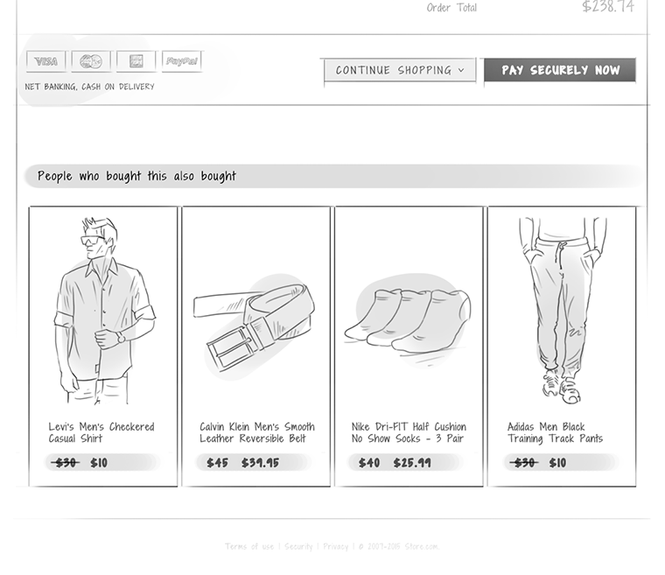
Introduction
eCommerce UX Design
http://ecommerceuxdesign.com/collection/website-header/

Slide 5
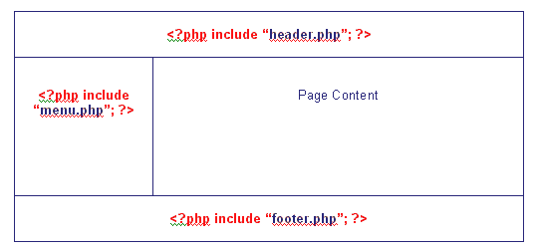
Structure

Slide 6
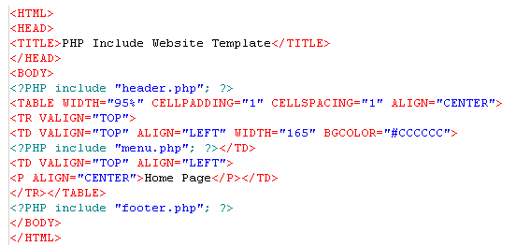
Index.php

Slide 7
First steps
<?php get_header(); ?>
<?php get_sidebar(); ?>
<?php get_footer(); ?>
These functions inject the contents of header.php, sidebar.php and footer.php
WordPress
The get_ functions are actually custom variants of the generic include function found in PHP. You could rewrite them as
<?php include('header.php'); ?>
<?php include('sidebar.php'); ?>
<?php include('footer.php'); ? >

Slide 8
Begining
<header>
<?php include "header.php"; ?>
</header>
<article><?php include "content.php"; ?></article>
<aside>
<?php include "sidebar.php"; ?>
</aside>
<footer><?php include "footer.php"; ?></footer>

Slide 9
Next example
<html>
<head>
<title>My cool website</title>
</head>
<body>
<div id="header">
<img src="logo.png" alt="Cool Website Logo" />
</div>
<div id="content">
<p>Awesome content goes here</p>
</div>
<div id="footer">
<p>Copyright 2011 Cool Site.</p>
</div>
</body>
</html>
header.htm,
index.htm
footer.htm.
<?php
include("templates/header.htm");
include("templates/index.htm");
include("templates/footer.htm");
?>

Slide 10
$action
Change index in your code (from templates/index.htm) to be $action
<?php
include("templates/header.htm");
if (!empty($_GET['action'])) {
$action = $_GET['action'];
$action = basename($action);
include("templates/$action.htm");
}
include("templates/footer.htm");
So now that we're only running our code when there is a parameter present, we need to write some code that's going to be ran when it's not present.

Slide 11
$action. Continue
<?php
include("templates/header.htm");
if (!empty($_GET['action'])) {
$action = $_GET['action'];
$action = basename($action);
include("templates/$action.htm");
} else {
include("templates/index.htm");
}
include("templates/footer.htm");
?>
<?php
include("templates/header.htm");
if (!empty($_GET['action'])) {
$action = $_GET['action'];
$action = basename($action);
if (!file_exists("templates/$action.htm")
$action = "index";
include("templates/$action.htm");
} else {
include("templates/index.htm");
}
include("templates/footer.htm"); ?>

Slide 12
<?php
include("templates/header.htm");
if (!empty($_GET['action'])) {
$action = $_GET['action'];
$action = basename($action);
if (!file_exists("templates/$action.htm"))
$action = "index";
if ($action == 'header' || $action == 'footer')
$action = "index";
include("templates/$action.htm");
} else {
include("templates/index.htm");
}
include("templates/footer.htm");

Slide 13
<?php
include("templates/header.htm");
// Set the default name
$action = 'index';
// Specify some disallowed paths
$disallowed_paths = array('header', 'footer');
if (!empty($_GET['action'])) {
$tmp_action = basename($_GET['action']);
// If it's not a disallowed path, and if the file exists, update $action
if (!in_array($tmp_action, $disallowed_paths) && file_exists("templates/{$tmp_action}.htm"))
$action = $tmp_action;
}
// Include $action
include("templates/$action.htm");
include("templates/footer.htm");

Slide 14
<!DOCTYPE html>
<?php
//set default name
$action = 'index';
//specify disallow paths
$disallow_paths = array('header', 'footer');
if (!empty($_GET['action'])){
$tmp_action = basename($_GET['action']);
//if it's not a diallowed path, and if the file exists, make $action
if (!in_array($tmp_action, $disallow_paths) && file_exists("templates/{$tmp_action}.htm"))
$action = $tmp_action;
}
echo "<html>
<head>
<link type='text/css' rel='stylesheet' href='stylesheet.css' />
<title>Title - " . $action . "</title>
</head>
<body>";
include("templates/header.htm");
include("templates/$action.htm");
include("templates/footer.htm");
echo "</body>
</html>";

Slide 15
Creating a Website Design Templating System Using PHP
Step 1
Create a folder on your server and name it "design".
Step 2
Create the following files in the design folder:
'header.html', 'footer.html', 'right_column.html', 'left_column.html'
Step 3
Create another folder and name it "pages"
Step 4
In the "pages" directory, create a page and give it the name: 'main.html'
Step 5
Now in the root directory create a file and give it the 'index.php'
Step 6
Add the following code to your 'index.php' file

Slide 16
<?php
if (isset($_REQUEST['page']))
{
if($_REQUEST['page'] !="")
if(file_exists("pages/".$_REQUEST['page'].".html"))
$page_content = file_get_contents("pages/".$_REQUEST['page'].".html");
else
if (file_exists($_REQUEST['page'].".html"))
$page_content = file_get_contents($_REQUEST['page'].".html");
else
echo "<center>Page:".$_REQUEST['page']." does not exist! Please check the url and try again!</center>";
}
else
$page_content = file_get_contents("pages/main.html");
$page_content = str_replace("!!HEADER!!", file_get_contents("design/header.html"),$page_content);
$page_content = str_replace("!!LEFT_COLUMN!!", file_get_contents("design/left_column.html"),$page_content);
$page_content = str_replace("!!RIGHT_COLUMN!!", file_get_contents("design/right_column.html"),$page_content);
$page_content = str_replace("!!FOOTER!!", file_get_contents("design/footer.html"),$page_content);
$page_content = str_replace("!!COMMON_TAGS!!", file_get_contents("design/common_tags.html"),$page_content);
echo $page_content;
?>
index.php

Slide 17
Code Explanation & How it Works. (1)
if (isset($_REQUEST['page'])) This php code will check to see if a page is requested.
if($_REQUEST['page'] !="") Of course, to eliminate errors, make sure a page is entered and it is not a blank argument.
if(file_exists("pages/".$_REQUEST['page'].".html")) Now we check to see if it exists in the default folder; in our case it is the pages folder. Note that we have included the '.html' extension here so we do not need to enter it when we request the page. By using this method, we also benefit from using standard html designs for the pages.

Slide 18
Code Explanation & How it Works. (2)
$page_content = file_get_contents($_REQUEST['page'].".html"); If every thing is alright, assign the contents of that page to a variable: $page_content. Note that the file_get_content function will not execute any code. That is: putting php code in your pages will not work. If you need to use any php code, either add it to your 'index.php' or to separate files and then include it in the 'index.php'.
else if (file_exists($_REQUEST['page'].".html")) $page_content = file_get_contents($_REQUEST['page'].".html"); These lines will extend and go further than the default folder.
You can use it to request pages in deeper folders in your website. For example, you can design pages in a sub-directory and request it in a similar way to requesting pages in the default folder using the following command in your browser: main_folder_of_files/index.php?page=sub-directory/page.html

Slide 19
Code Explanation & How it Works. (3)
else echo "<center>Page:".$_REQUEST['page']." does not exist! Please check the url and try again!</center>"; We looked for the requested page in the default folder, in the sub-directory requested but we did not find it....then it does not exist. Print an error statement!!!
else $page_content = file_get_contents("pages/main.html"); If no page is requested at all, go to a default page.

Slide 20
Code Explanation & How it Works. (4)
$page_content = str_replace("!!HEADER!!", file_get_contents("design/header.html"),$page_content); $page_content = str_replace("!!LEFT_COLUMN!!", file_get_contents("design/left_column.html"),$page_content); $page_content = str_replace("!!RIGHT_COLUMN!!", file_get_contents("design/right_column.html"),$page_content); $page_content = str_replace("!!FOOTER!!", file_get_contents("design/footer.html"),$page_content);
This is the fun part! Our $page_content variable now holds the design and the content of the page requested. We simply use the str_replace function to replace our tag holders with our predesigned pages.

