Slide 1
Introduction to Databases by Dr. Soper extended with more examples
Chapter 1

Slide 2
Topic Objectives
Know the potential problems with lists
Understand the reasons for using a database
Understand how related tables avoid the problems associated with lists
Learn the components of a database system
Learn the elements of a database
Learn the purpose of database manadgement system (DBMS)
Understand the function of database application

Slide 3
Purpose of a DataBase
The purpose of a database is:
  To store data
  To provide an organizational structure for data
  To provide a mechanism for quering, creating, modifying, and deleting data
A database can store information and relationships that are more complicated than a simple list

Slide 4
Problems with Lists: Redundancy
In a list, each row is intended to stand on its own. As a result, the same information may be entered several times
  For example, a list of projects may include the project manager's name, ID, and phone extention.
    If a particular person is currently managing 10 progects, his/her information would appear in the list 10 times

Slide 5
Problems with Lists: Multiple Themes
In a list, each row may contain information on more than one theme or business concept
As a result, certain information might appear in the list only if information about other themes or business concepts is also present
  For example, a list of projects may include project manager information (Name, ID, and Phone Extention) and project information (ProjectName, ID, StartDate, Budget) in the same row

Slide 6
List Modification Issues
Redundancy and multiple themes in lists create modification problem
  Deletion problems
  Update problems
  Insertion problems

Slide 7
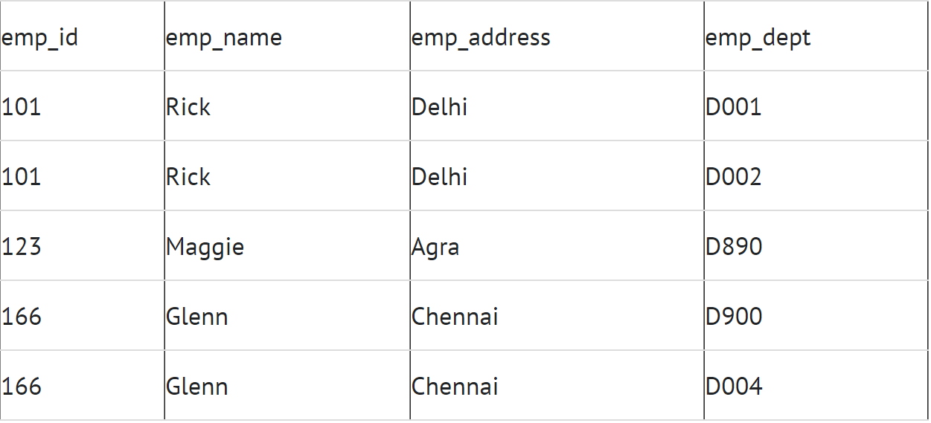
Problems with the lists. Update anomaly
If we want to update the address of Rick then we have to update the same in two rows or the data will become inconsistent.
If somehow, the correct address gets updated in one department but not in other then as per the database, Rick would be having two different addresses

Slide 8
Problems with the lists. Insert anomaly
Suppose a new employee joins the company, who is under training and currently not assigned to any department then we would not be able to insert the data into the table if emp_dept field doesn’t allow nulls.

Slide 9
Problems with the lists. Update anomaly
Suppose, if at a point of time the company closes the department D890 then deleting the rows that are having emp_dept as D890 would also delete the information of employee Maggie since she is assigned only to this department.

Slide 10
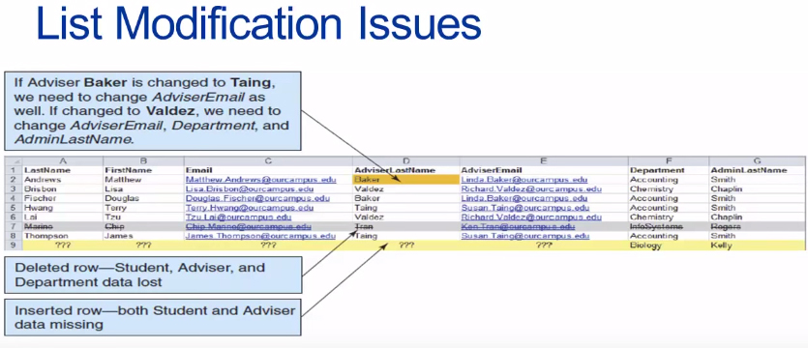

Slide 11
Addressing Information Complexities
Relational databases are designed to address many of the information complexity issues that arise business

Slide 12
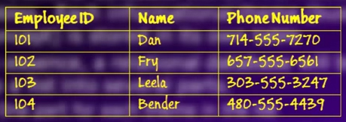
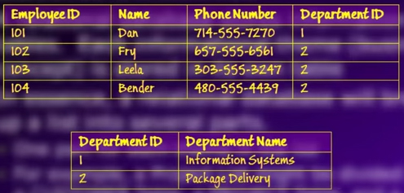
Relational Databases
A relational databases stores information in table. Each informational theme (business concept) is stored in its on table
In essence, a relational database will break-up a list into several parts.
  One part for each theme in the list
  For example, a Project List might be divided into a CUSTOMER Table, a PROJECT Table, and a PROJECT_MANAGER Table

Slide 13
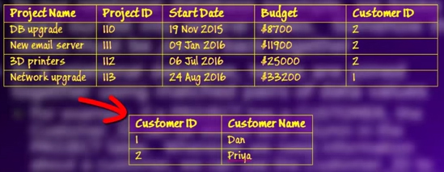
Putting the Pieces Back Together
In our relational database example, we broke apart our list into several tables. Somehow the tables must be joined back together
In relational database, tables are joined together using matched pairs of values
  For example, if a PROJECT has CUSTOMER, the CUSTOMER_ID can be stored as column in the PROJECT table. Whenever we need information about a customer, we can use Customer_ID to look up the customer information in the CUSTOMER table

Slide 14
EXAMPLE
  http://enos.itcollege.ee/phpmyadmin/
  User: test
  Password: t3st3r123

Slide 15
Sounds like More Work, Not Less
A relational databases is more complicated than a list
However, a relational database minimizes data redundancy, preserves complex relationships among topic, and allows for partial data (null values)
Furthermore, a relational databese provides a solid foundation for creating user interface forms and reports

Slide 16
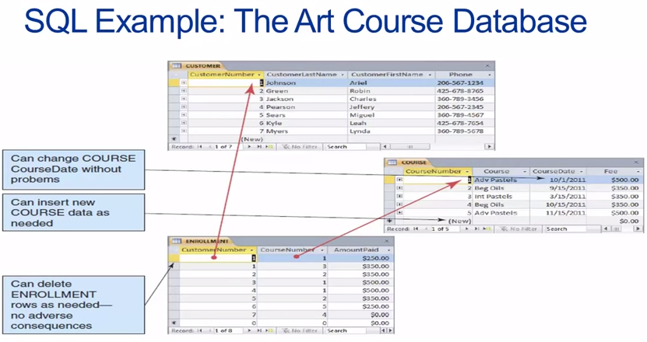
The Structured Query Language (SQL)
The Structured Query Language (SQL) is an international standart language for creating, processing, and querying databases and their tables
The vast majority of data-driven applications and websites use SQL to retrieve, format, report, insert, delete, and/or modify data for users

Slide 17
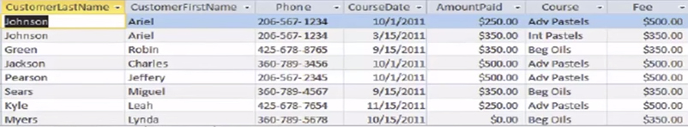
SQL Example
We can use SQL to combine the data in the three tables in the Art Course Database to recreate the original list structure of the data
  We do this using a SQL SELECT statement
  SELECT Customer.customerLastname,
  Customer.customerFirstName,
  Customer.phone,
  Course.courseDate,
  Enrollment.amountPaid,
  Course.course,
  Course.fee
  FROM Customer, Enrollment, Course
  WHERE Customer.customerNumber=Enrollment.customerNumber
  AND Course.courseNumber = Enrollment.courseNumbe

Slide 18
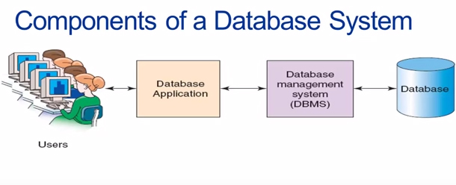
Database Systems
The four components of a database system are:
  Users
  Database Application(s)
  Database Management System (DBMS)
  Database

Slide 19
Users
A user of a database system will:
  Use a database application to keep track of information
  Use different user interface forms to enter, read, delete, and query data
  Produce report

Slide 20
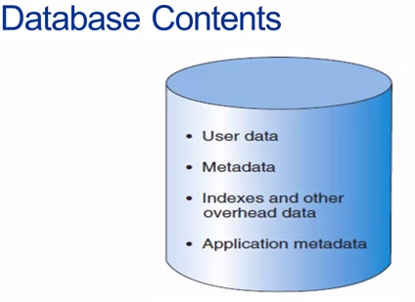
The Database
A database is a self-describing collection of related records
Self-describing:
  The database itself contains the definition of its structure
  Metadata are data describing the structure of the data in the database
Tables within a relational database are related to each other in some way

Slide 21
Database Management System (DBMS)
A Database management system (DBMS) serves as an intermediary between database applications and database
The DBMS manages and controls database activities
The DBMS creates, processes, and administers the databases it control

Slide 22
Functions of a DBMS
Create databases
Create tables
Create supporting structures
Read database data
Modify database data (insert, update, delete)
Maintain database structures
Enforse rules
Control concurency
Provide security
Perform data backup and recovery

Slide 23
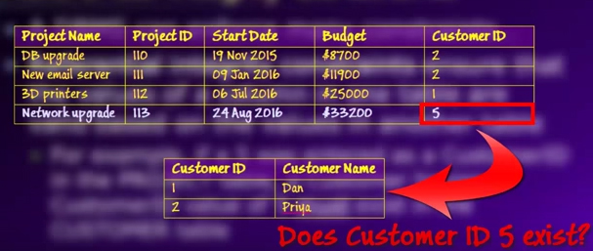
Referential Integrity Constraints
A DBMS can enforse many constraints...
Referential integrity constraints ensure that the values of a column in one table are valid based on the values in another table
  For example, if a 5 was entered as CustomerId in the PROJECT table, a Customer having a CustomerID value of 5 must exist in the CUSTOMER table

Slide 24
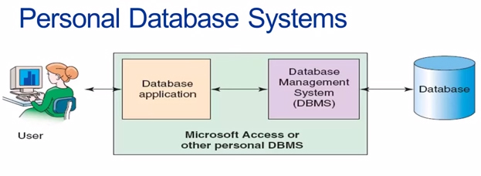
Database Applications
A database application is a set of one or more computer programs or websites that serve as a intermediary between the user and the DBMS
Personal Database Systems
Personal database systems typically:
  Support one application
  Have only a few tables
  Are simple in design
  Involve only one computer
  Support one user at a time

Slide 25
Enterprise-Level Database System
Enterprise-Level database systems typically:
  Support several users simultaneously
  Support more than one application
  Involve multiple computers
  Are complex in design
  Have many tables
  Have many databases

Slide 26
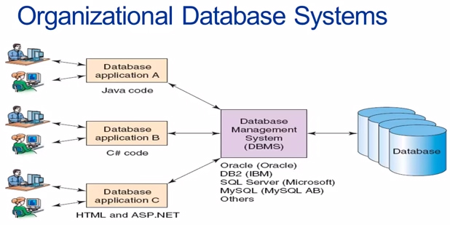

Slide 27
Commercial DBMS Products
Example Desctop DBMS Products
  Microsoft Access
Example Organizational DBMS Products
  SQL Server
  Oracle
  MySQL
  DB2

