Slide 1
Database, tables and normal forms
Erika Matsak, Phd

Slide 2
A Database Schema
Schema Owner
[1]
Tables
Indexes
Procedures
Views
Constraints
schema objects
1) Stephens, R.K. and Plew. R.R., 2001. Database Design. SAMS, Indianapolis , IN. (with slight changes by V.G.D.)

Slide 3
A Database with Multiple Tables
[1]
Publishers
Books
Customers
Authors
Inventory
Orders
1) Stephens, R.K. and Plew. R.R., 2001. Database Design. SAMS, Indianapolis , IN. (with slight changes by V.G.D.)

Slide 4
Three Types of Relationship
There are three types of table relationship:
One to one or denoted as 1:1
One to many or denoted as 1:M
Many to Many or denoted as M:N

Slide 5
Notation example
One Rep could have one or more customer (one to many) using
Primary and foreign key to create the relationship.
Customer
Customernum (PK) Customername Street City State Zip Balance CreditLimit Repnum (FK)
1
Rep
Repnum (PK) Lastname Firstname Street City State Zip Commission Rate
M

Slide 6
Dependencies
Functional dependency: The value of one attribute depends entirely on the value of another.
Partial dependency: An attribute depends on only part of the primary key. (The primary key must be a composite key.)
Transitive dependency: An attribute depends on an attribute other than the primary key.
Relational algebra from set theory

Slide 7
Referential Integrity
Referential Integrity means that the Foreign key must match in terms of actual values and data types with the related Primary Key.

Slide 8
Examples from Premier Database – Primary Key
Repnum uniquely identifies the Rep table
and is the primary key of this table.

Slide 9
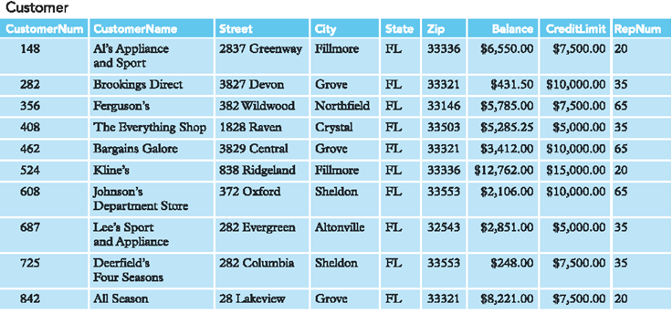
Examples from Premier Database – Primary Key
Customernum uniquely identifies the Customer table
and is the primary key of this table.

Slide 10
Examples from Premier Database – Foreign Key
Repnum is a Foreign key borrowed from Rep table

Slide 11
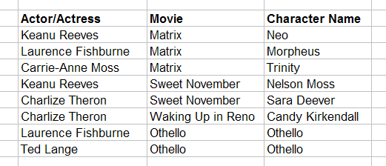
Primary Key
Roles (Performances)
primary key fields
A primary key can consist of more than one field.

Slide 12
Foreign Key
primary key field
parent table
Directors
relationship
child table
Movies
foreign key field

Slide 14
Figure 14.2 Example relations

Slide 15
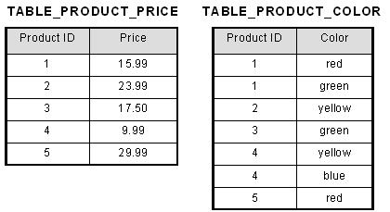
First Normal Form (1NF)
Now first normal form is satisfied, as the columns on each table all hold just one value.
This table is not in first normal form because the [Color] column can contain multiple value
PRIMARY KEY?

Slide 16
Normalize into 1NF
Separate repeating groups into new tables.
Start a new table for the repeating data.
The primary key for the repeating group is usually a composite key.
First normal form (1NF) is a property of a relation in a relational database. A relation is in first normal form if and only if the domain of each attribute contains only atomic (indivisible) values, and the value of each attribute contains only a single value from that domain.^{[1]}
The first definition of the term, in a 1971 conference paper by Edgar Codd, defined a relation to be in first normal form when none of its domains have any sets as elements.^{[2]}

Slide 17
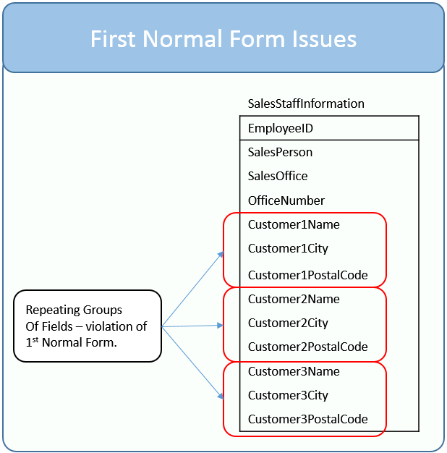
Once a table is in first normal form it is easier to search, filter, and sort the information. The rules to satisfy 1st normal form are:
The table stores information in rows and columns where one or more columns, called the primary key, uniquely identify each row.
Each column contains atomic values, and there are not repeating groups of columns.
When a value is atomic, the values cannot be further subdivided.
For example, the value “Chicago” is atomic; whereas “Chicago; Los Angeles; New York” is not. Related to this requirement is the concept that a table should not contain repeating groups of columns such as Customer1Name, Customer2Name, and Customer3Name.

Slide 18
Second normal form
Second normal form (2NF) is a normal form used in database normalization. 2NF was originally defined by E.F. Codd in 1971.^{[1]}
A relation that is in first normal form (1NF) must meet additional criteria if it is to qualify for second normal form. Specifically: a relation is in 2NF if it is in 1NF and no non-prime attribute is dependent on any proper subset of any candidate key of the relation. A non-prime attribute of a relation is an attribute that is not a part of any candidate key of the relation.
Put simply, a relation is in 2NF if it is in 1NF and every non-prime attribute of the relation is dependent on the whole of every candidate key.

Slide 19
Second normal form
Second normal form (2NF) further addresses the concept of removing duplicative data:
Meet all the requirements of the first normal form.
Remove subsets of data that apply to multiple rows of a table and place them in separate tables.
Create relationships between these new tables and their predecessors through the use of foreign keys.

Slide 20
Simple example
KEY
Office_city | Position | Salary | Computer
Washington | Cleaner | 20000 | No
Tokyo | Software developer | 40000 | Yes
Washington | Software developer | 25000 | Yes
Office_city | Position | Salary
Washington | Cleaner | 20000
Tokyo | Software developer | 40000
Washington | Software developer | 25000
Position | Computer
Cleaner | No
Software developer | Yes
Software developer | Yes

Slide 21
Though they are used to describe which office the SalesPerson is based out of, the SalesOffice and OfficeNumber columns themselves don’t serve to describe who the employee is.
If all the SalesOffices close, it doesn’t mean you have to delete the records containing sales people.
NON-FUNCIONAL RELATION

Slide 22
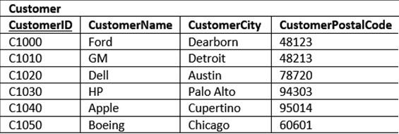
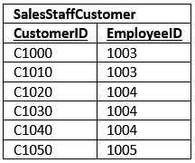
An intersection table is useful when you need to model a many-to-many relationship. Each column is a foreign key.

Slide 23
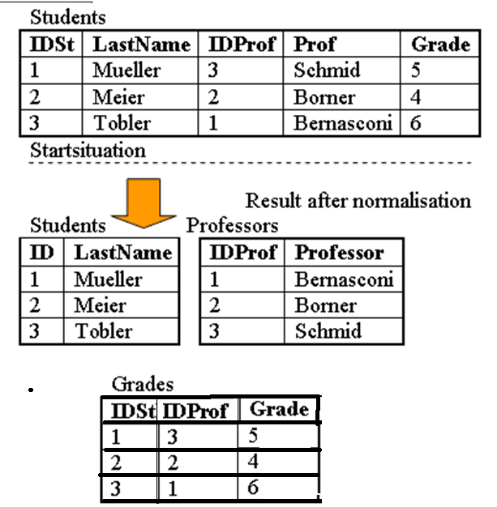
Second Normal Form (2NF)
The table in this example is in first normal form (1NF) since all attributes are single valued. But it is not yet in 2NF.
If student 1 leaves university and the tuple is deleted, then we loose all information about professor Schmid, since this attribute is fully functional dependent on the primary key IDSt.
To solve this problem, we must create a new table Professor with the attribute Professor (the name) and the key IDProf. The third table Grade is necessary for combining the two relations Student and Professor and to manage the grades.
Besides the grade it contains only the two IDs of the student and the professor. If now a student is deleted, we do not loose the information about the professor.

Slide 24
Definition of third normal form
The third normal form (3NF) is a normal form used in database normalization. 3NF was originally defined by E.F. Codd in 1971.^{[2]} Codd's definition states that a table is in 3NF if and only if both of the following conditions hold:
The relation R (table) is in second normal form (2NF)
Every non-prime attribute of R is non-transitively dependent on every key of R.
A non-prime attribute of R is an attribute that does not belong to any candidate key of R.^{[3]}
A transitive dependency is a functional dependency in which X → Z (X determines Z) indirectly, by virtue of X → Y and Y → Z (where it is not the case that Y → X).^{[4]}

Slide 25
Third normal form (3NF)
Third normal form (3NF) goes one large step further:
Meet all the requirements of the second normal form.
Remove columns that are not dependent upon the primary key.

Slide 26
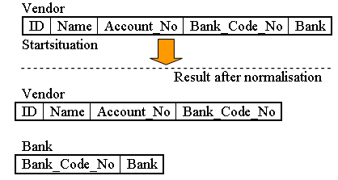
Third normal form (3NF)

Slide 27
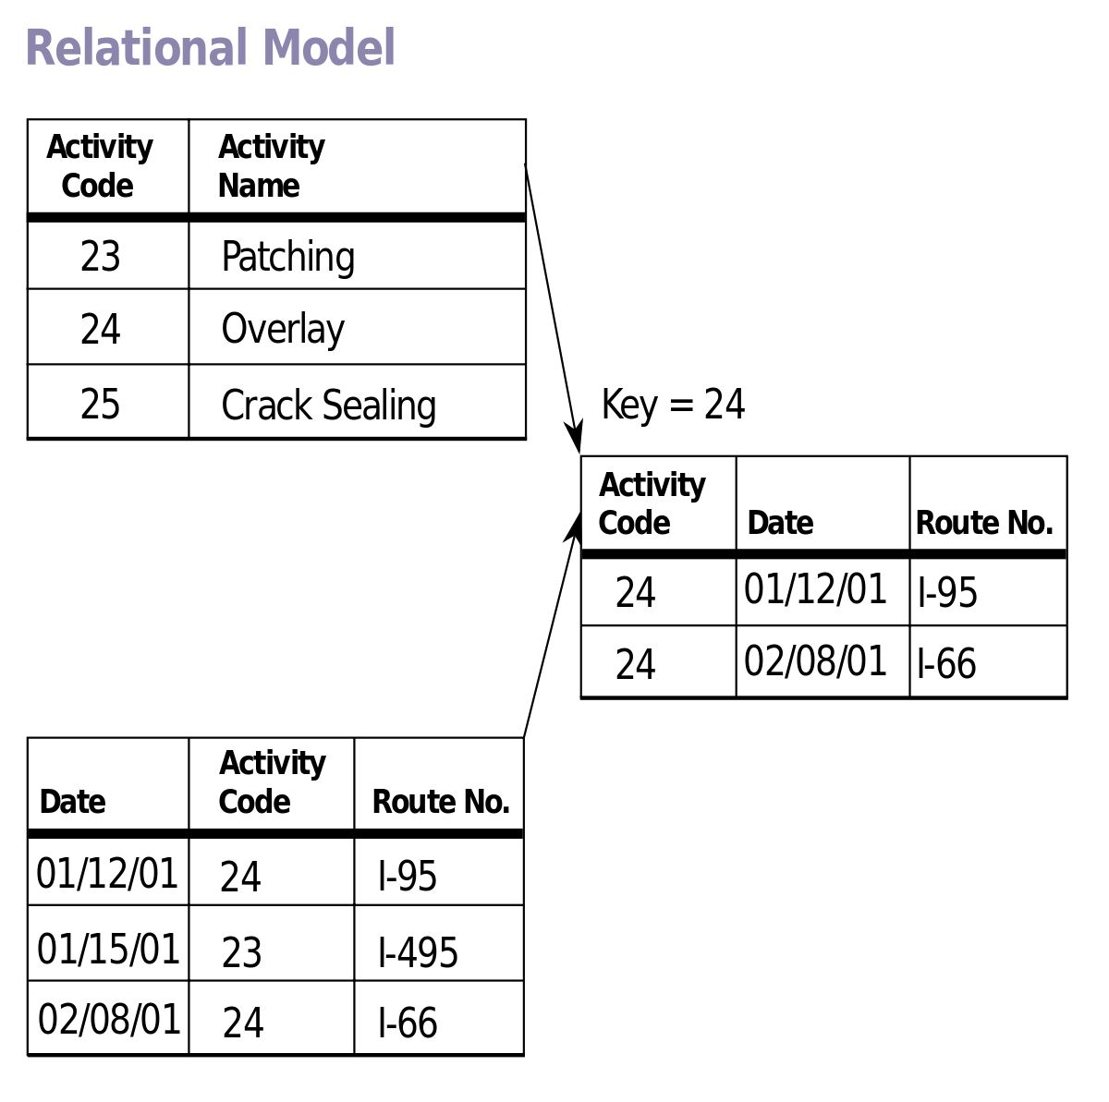
What’s wrong here?

Slide 28
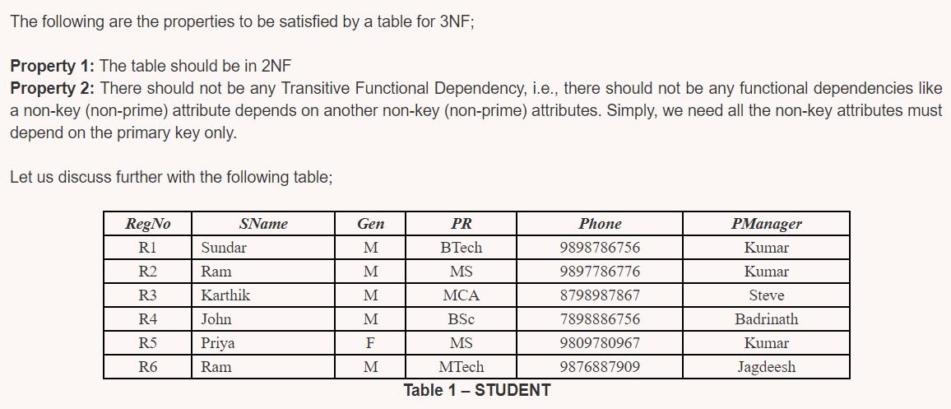

Slide 29
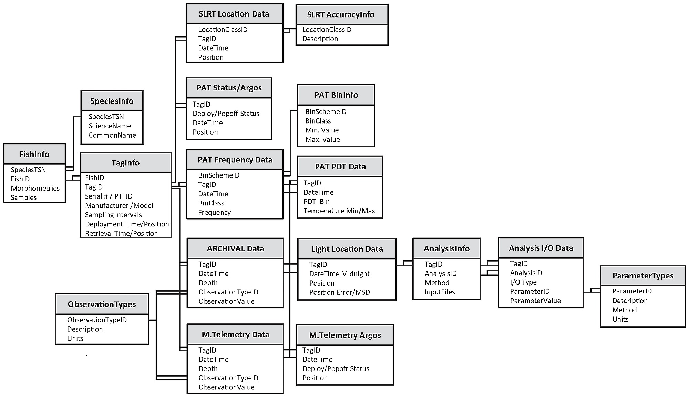
Let’s correct

Slide 30
Exercise normalization
The following table is already in first normal form (1NF). There is only one entry per field. Please convert this table to the third normal form (3NF)
UnitID | StudentID | Date | TutorID | Topic | Room | Grade | Book | TutEmail
U1 | St1 | 23.02.03 | Tut1 | GMT | 629 | 4.7 | Deumlich | tut1@fhbb.ch
U2 | St1 | 18.11.02 | Tut3 | GIn | 631 | 5.1 | Zehnder | tut3@fhbb.ch
U1 | St4 | 23.02.03 | Tut1 | GMT | 629 | 4.3 | Deumlich | tut1@fhbb.ch
U5 | St2 | 05.05.03 | Tut3 | PhF | 632 | 4.9 | Dümmlers | tut3@fhbb.ch
U4 | St2 | 04.07.03 | Tut5 | AVQ | 621 | 5.0 | SwissTopo | tut5@fhbb.ch

