Slide 1
3NF

Slide 2
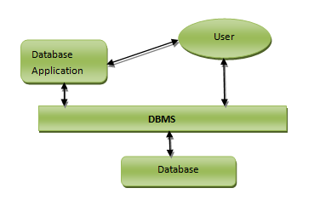
Just for remaining

Slide 3
Step 1: Create first normal form (1NF)
The database normalization process involves getting data to conform to progressive normal forms, and a higher level of database normalization cannot be achieved unless the previous levels have been satisfied. First normal form is the basic level of database normalization.
For 1NF, ensure that the values in each column of a table are atomic; which means they are unique, containing no sets of values.

Slide 4
Step 2: Define relationships
Three types of relations can be established:
One-to-(Zero or)-one (Example: marriage)
One-to-(Zero or)-many (Example: kids)
Many-to-many (Example: facebook)
2NF is about the relations between the composite key columns and non-key columns. That means the non-key columns have to depend on the whole composite key

Slide 5
Step 4: Third Normal Form (3NF)
This requires that all columns depend directly on the primary key.
Tables violate the 3NF when one column depends on another column which in turn depends on the primary key. (A transitive dependency)

Slide 6
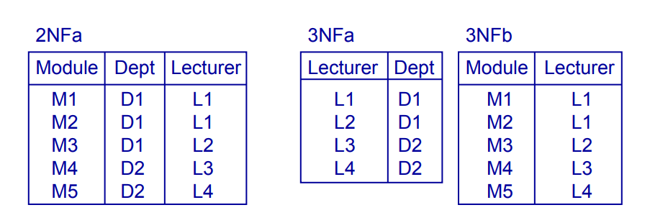
2NF to 3NF Example

Slide 7
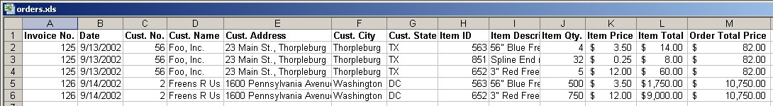
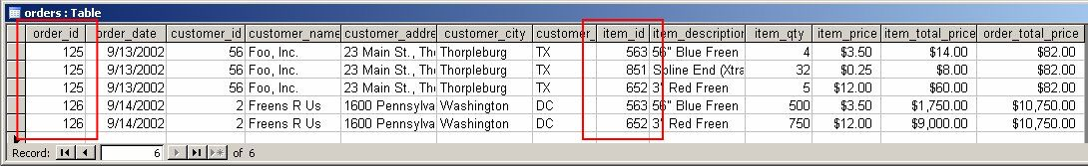
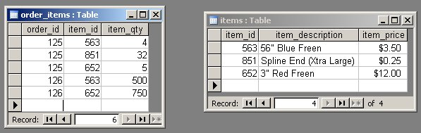
Each order can have many items; each item can belong to many orders.

Slide 8
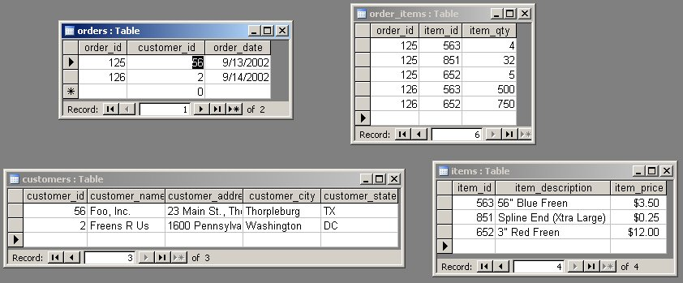
Third Normal Form: No Dependencies on Non-Key Attributes

Slide 9
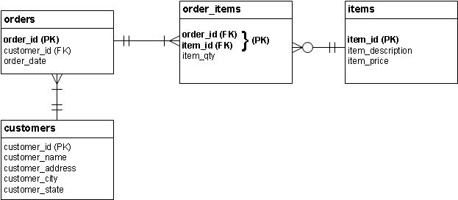
id

Slide 10
Normalisation and Design
Normalisation is related to DB design
A database should normally be in 3NF at least
If your design leads to a non-3NF DB, then you might want to revise it
When you find you have a non-3NF DB
Identify the FDs that are causing a problem
Think if they will lead to any insert, update, or delete anomalies
Try to remove them

Slide 11
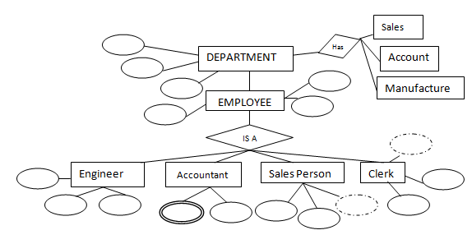
Design example 1

Slide 12
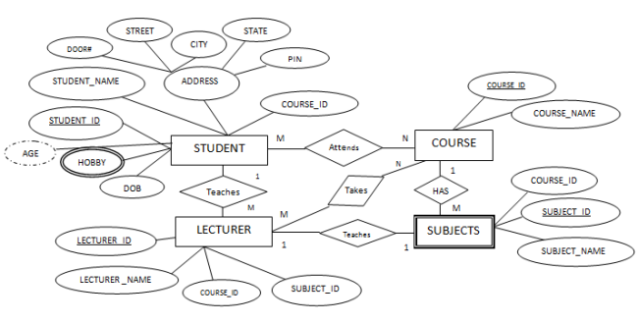
Design example 2

Slide 13
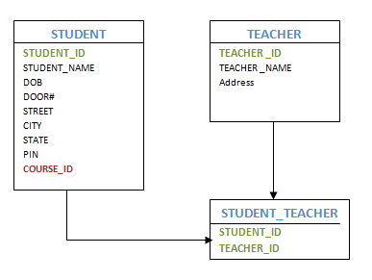
Entity–Relationship model (ER model)

Slide 14
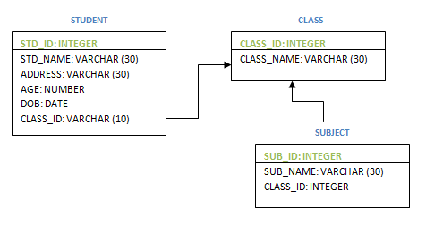
Physical data model
Physical data model represent the model where it describes how data are stored in computer memory, how they are scattered and ordered in the memory, and how they would be retrieved from memory.

